Slide 1
projet
Groupe et roles
2022 - 2023

Slide 2
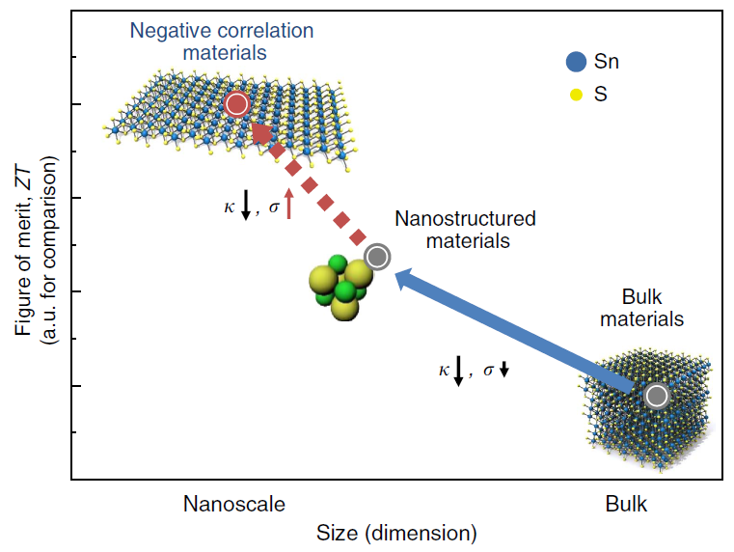
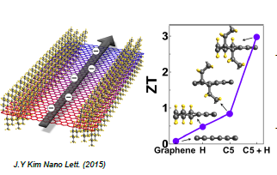

Motivations
Nature 556 355–9
Nature 556 355–9
functionalization can introduce peaks in the DOS at the band edge resulting in a large enhancement in the Seebeck coefficient
intercalate atoms/ions to induce energy filtering
superlattice materials, nano structuring, resonant states
band convergence for multivalley materials
Electrothermal characterization on submicronic samples

Slide 3
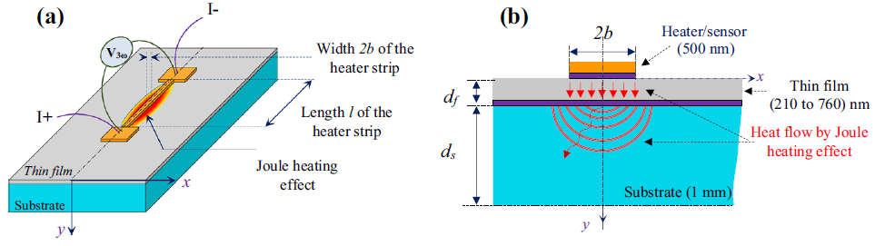
Cross plane κ by 3ω
Penetration depth
a thin metallic line is deposited onto the sample serves as a heater and temperature sensor.
tuning thermal penetration depth with ω

Slide 4
Parametrage du modele et librairies
a thin metallic line is deposited onto the sample serves as a heater and temperature sensor.
tuning thermal penetration depth with ω

Slide 5
Resultats et discussions
a thin metallic line is deposited onto the sample serves as a heater and temperature sensor.
tuning thermal penetration depth with ω

Slide 6
Validation experimentale
a thin metallic line is deposited onto the sample serves as a heater and temperature sensor.
tuning thermal penetration depth with ω

Slide 7
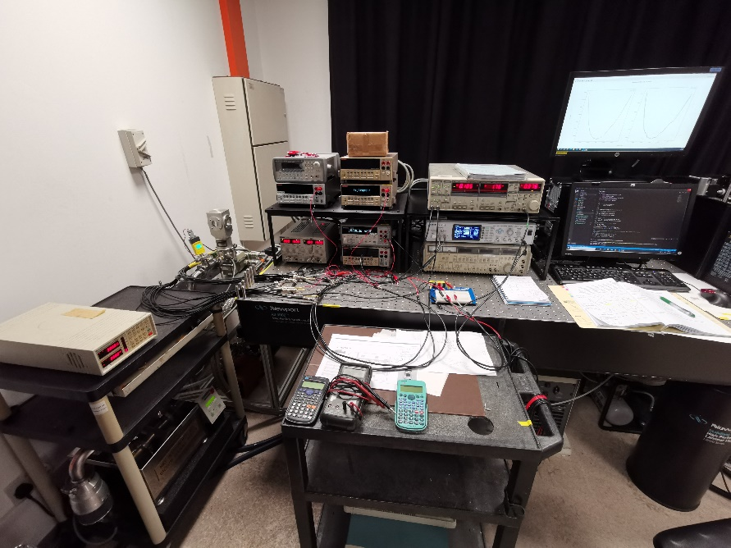
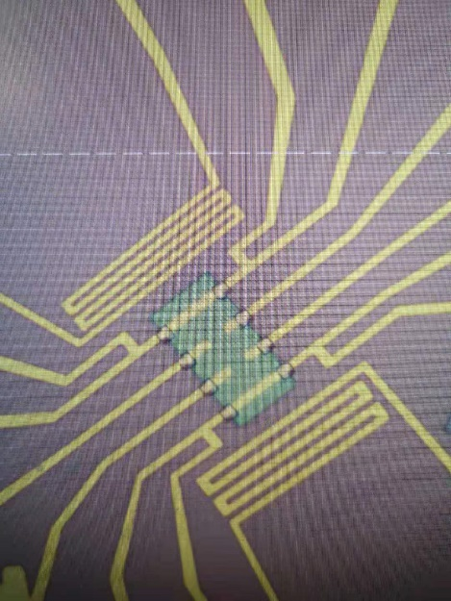
Validation experimentale
Seebeck test structure
Cross plane k by 3w method 10 – 475 K
Thermoelectric coefficient
I-V and PC

Slide 8
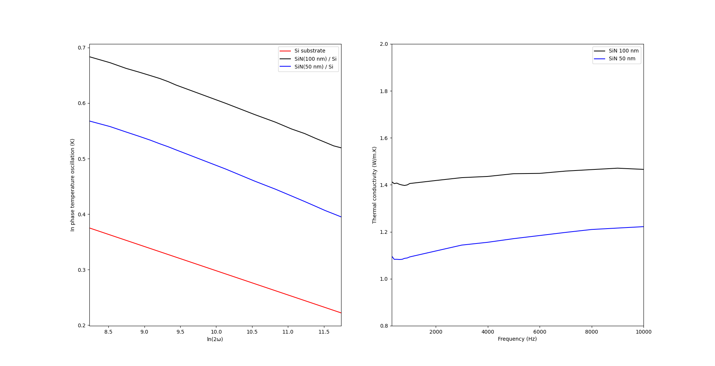

Cross plane κ
SiN, 100nm
SiN, 50nm
K_{f=100nm} = 1.428 W/mK
$$∆T_{f50}=\frac{P_{rms}∙d_{f}}{2b∙κ_{f}}$$
K_{f=50nm} = 1.136 W/mK
Silicon substrate
differential measurement for submicronic films
on going measurement on Bi₂O₂Se 3ω at CINTRA and TDTR at INSP

Slide 9
Conclusions et perspectives
xxxxxxxxxxxxxxxxxxxxxxxx

